Slide 1
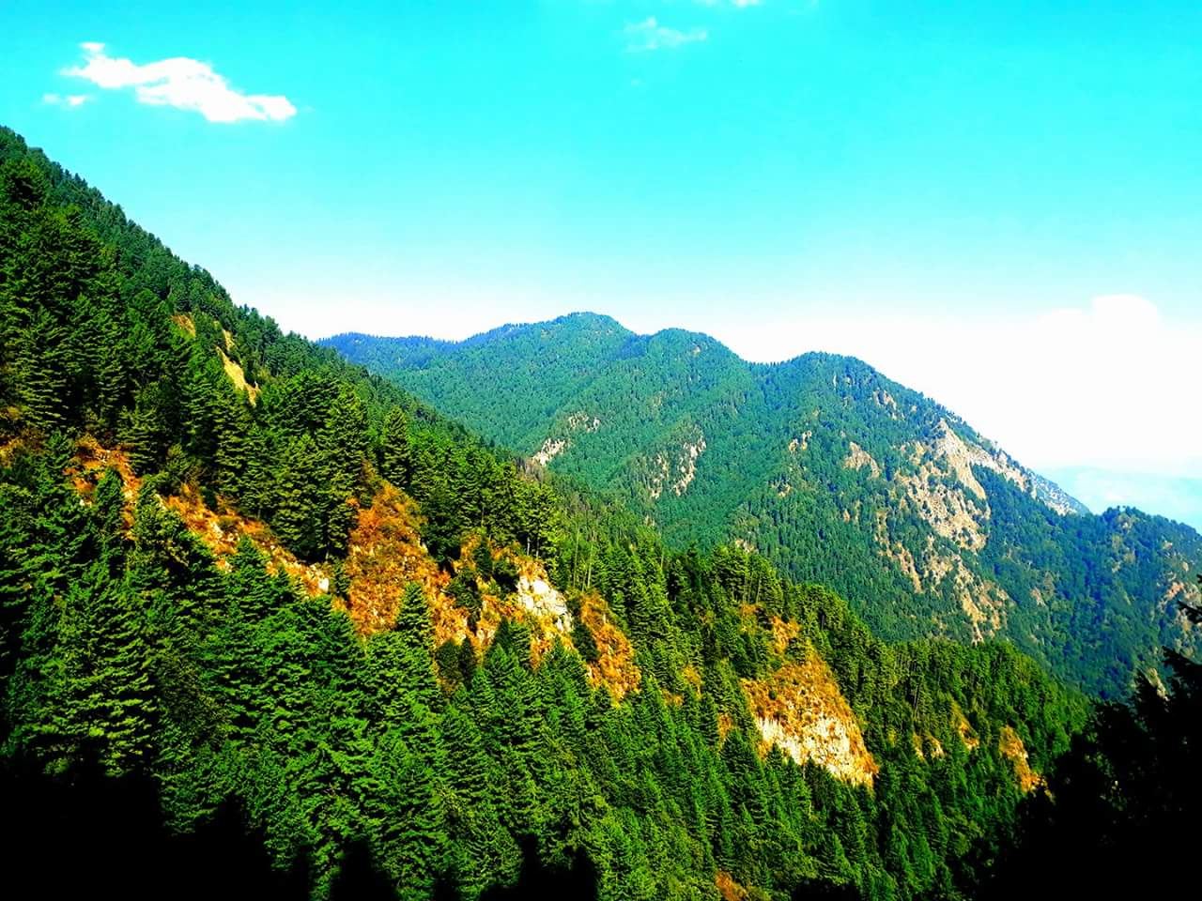
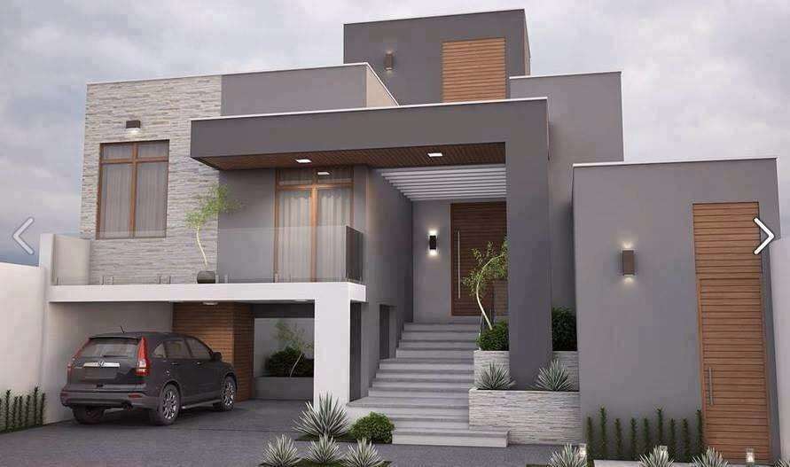
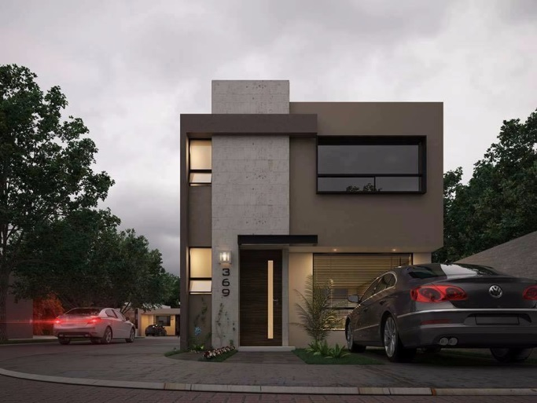
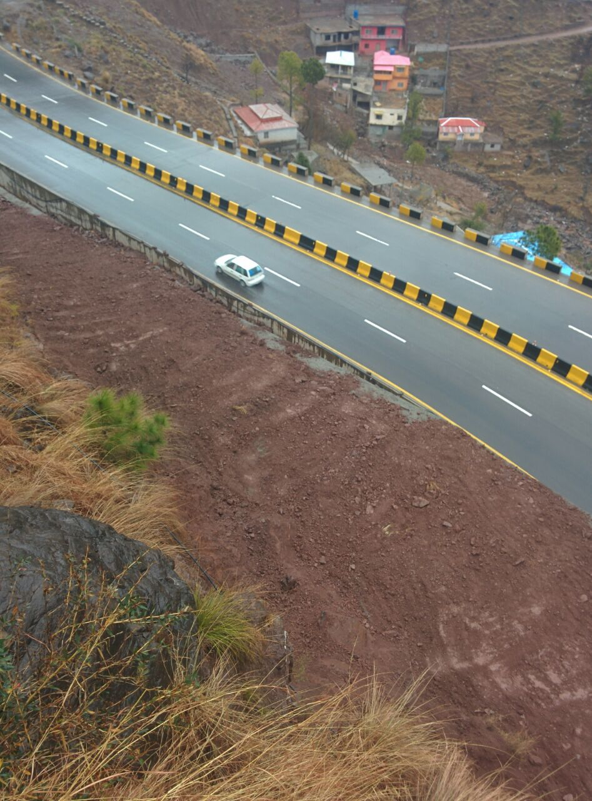
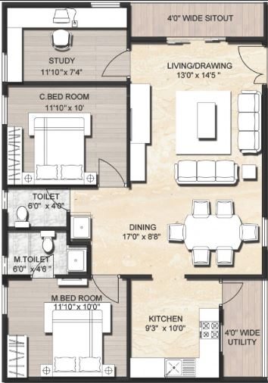
Murree ExpresWay
Swiss Four Season
Resort Villas

Slide 2
Introduction
Swiss Four Season Developers .
We are a German Based Company Investing in Tourisms Project in Pakistan, as a part of our national Interest to Promote the Economy with contributing our share of effort toward Prosperous Pakistan.
Our Mission is to setup 3 to 4 Star Holiday Home and Villas in different Natural Green Habitats. We believe in Serving and providing Quality in Hospitality Industry.
Our Clients Satisfaction & Happiness is our Goal .
AL Ghafoor Town Yazman
We are proud to mention with our Positive Motivated Team we have accomplished & complted Al Ghafoor Town Yazman Mandi 12 Acrs all development work . Now We are in Selling Phase.
www.alghafoortown.com
Al Madina Center
Commercial Development on 5 Kanal Land located on Bahawalpur Airport Road
Double Story consist of 54 Showrooms for Brands. www.almadinacenter.com
www.4Season swiss.com
2

Slide 3
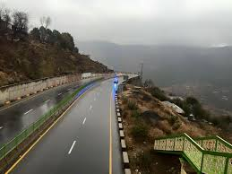
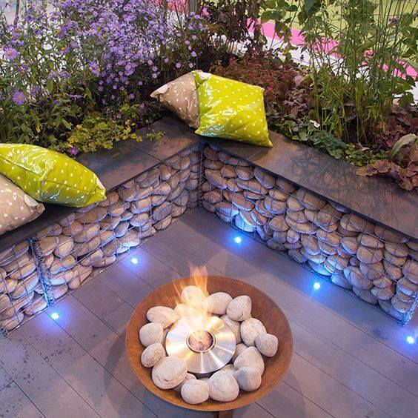
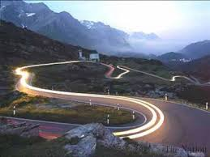
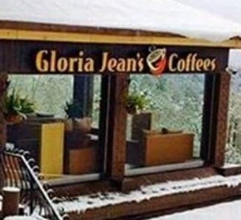
Project Summary
OUR PROJECTLOCATED ON N75 EXPRESS MPOTORWAY MURREE APPROXIMATEL 9 MINUTE DRIVE DISTANCE TO GLORIA JEANS COFFEE SHOP .
Gloria Jeans Coffee Shop 7 KM
Abshar Restaurent 1 KM
Murree Bazar 12 KM
Islamabd Zero Point 51 KM
Islamabd Airport 60 KM
Sea Level Altitude 5700 Ft
The Project will be Consist of 40 Villas in Various Sizes & Elegant Designs , Plus a 360 View with revolving restaurant of 200 seats.
www.4Season swiss.com
3

Slide 4
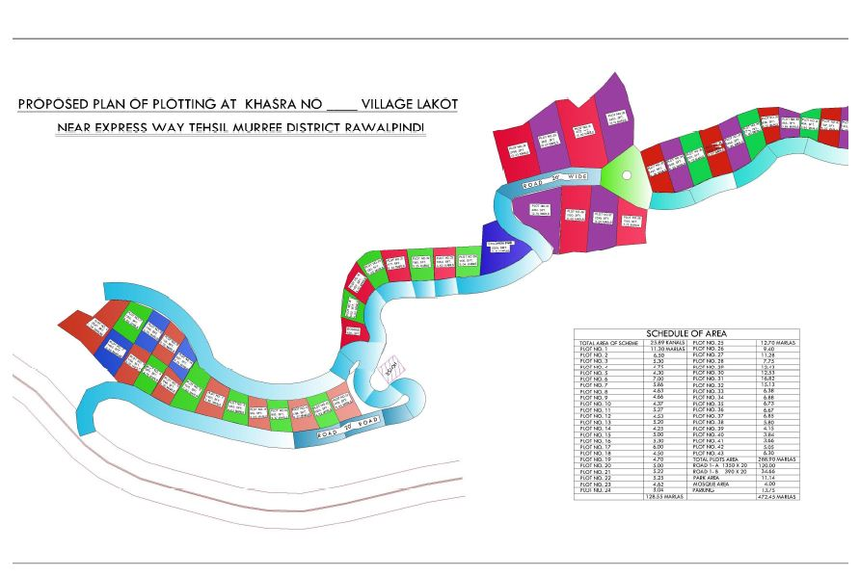
Project Summary
THE PROJECT AQUIRED AREA 26 KANAL LAND
WITH DIRECT ACCESS TO MAIN MOTOR WAY
OR N75 ROAD IS JUST 200 FEET AWAY MAIN
ACCESS WITH DIRECT PRIVATE ROAD
www.4Season swiss.com
4

Slide 5
Project Summary
Optional Services.
Rental Time Share Management.
For Example Mr. Ali Buys a Villa ( Land Plus Fully Furnished Building ) at 7 Million Rupee . Mr. Ali Use the property for Holiday staying like 60 days a Year but rest of 10 Months it stay vacant. Four Season Management Team Take Care of the property for maintenance and security plus rents out to Evaluated Clients for balance 300 Days
For Example Rent Share Income…………………..
Swiss Villa Price 70,00,000 Rs
Rental Income Guaranteed after contract Signing per Year 10,20,000 Rs
Note.. Certain condition applies we will be happy to provide more information upon meeting in detail. As explained above Return on Investment (ROI) is about 7 Years. Further Coming Years income may flow as rental income plus property appreciated value in favor of client.
www.4Season swiss.com
5

Slide 6
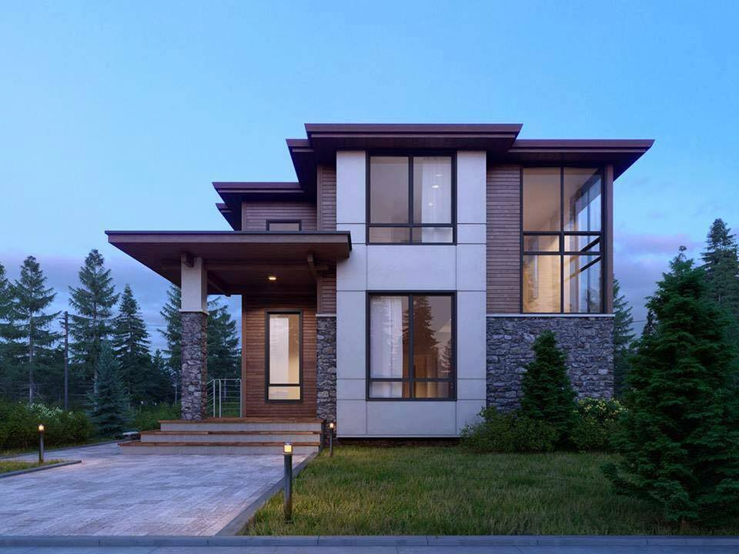
Nest Villas
Nest Villa
Plot Area 1250 Sq Ft
Ground Floor 1000 Sq Ft
First Floor 900 Sf Ft
Hall 1
Bedroom 3
Washroom 2
Kitchen 1
Parking 1
Note . Above Mentioned Design can be modified as per Client requirement and extra cost will be calculated upon final drawing
And charges will be invoiced in addition to above Sale price.
www.4Season swiss.com
6

Slide 7
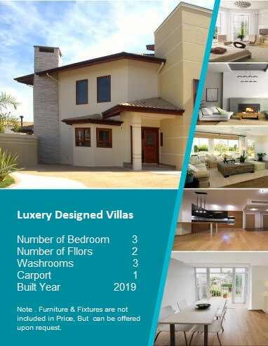
Luxery Villas
Luxery Villa
Plot Area 1500 Sq Ft
Ground Floor 1000 Sq Ft
First Floor 900 Sf Ft
Hall 1
Bedroom 3
Washroom 2
Kitchen 1
Parking 1
Note . Above Mentioned Design can be modified as per Client requirement and extra cost will be calculated upon final drawing
And charges will be invoiced in addition to above Sale price.
www.4Season swiss.com
7

Slide 8
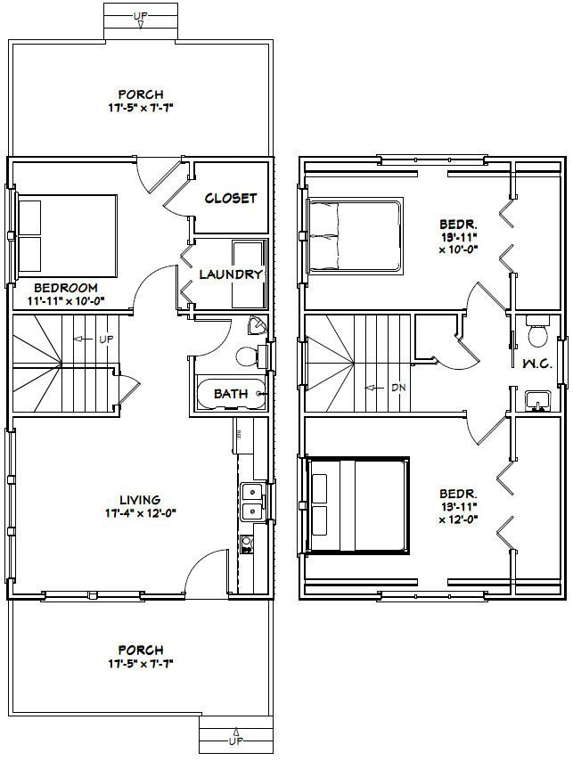
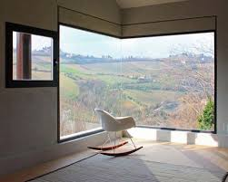
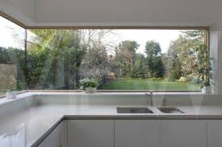
Nest Villas
www.4Season swiss.com
8

Slide 9
Booking & Sale Plan
We Offer a very Balanced Payment plan. Sale Value 7,000,000 Rs
Advance Payment Upon Signing Contract 10 % ie…. 7,00,000 Rupee
Upon Completion of Earth Work Plus Foundation Work 15 % 10,50,000 Rupee
Upon Completion of Lenter Level 60 Days after Signing Contract 15 % 10,50,000 Rupee
Upon Completion of Lenter Level 90 Days after Signing Contract 15 % 10,50,000 Rupee
Upon Completion of Lenter Level 120 Days after Signing Contract 15 % 10,50,000 Rupee
Upon Completion of Lenter Level 150 Days after Signing Contract 15 % 10,50,000 Rupee
Upon Completion of Lenter Level 180 Days after Signing Contract 15 % 10,50,000 Rupee
Handover to Owner at End or 8 Month from signing date of Contract
Alternative Payment Plan . Sale Value 9,000,000 Rs
Advance Payment Upon Signing Contract 5 % ie…. 90 Lacs 4,50,000 Rupee
Each Month Installment 2,37,500 Rs x 36 Month Installment 85,50,000 Rupee
Upon Completion and Handover after 8 Months If Client Sign a Rent
Time Share Contract Client will receive …………………………… 87,500 Rupee/Month Rental Income
How ever Owner will Have the right to Stay 60 Days per Year in Same Or similar house.
- After 8 Month or Completion of House Installment will be reduced to 1,50,000 Rupee
www.4Seasonswiss.com
9

Slide 10
Key Benefits
FOUR SEASON REAL ESTATE OFFERS
4, 5, 7 & 10 Marla Residential Plots are available.
Good Location & View Of Valley on Main Murree Express Way
Just a few KM to Gloria Jeans Coffee Shop
Plots available on Installment and cash basis
Immediate Possession & Transfer of ownership Mutation
With All Basic Facilities:
1- Easy Access & Carpeted Road N75 Open in Seasons.
2- Gated Community
3- Electricity
4- Water Supply
5- Sui Gas
6- Sewerage System
7- Facing Valley
8- Security Guard 42x7 and Boundary Wall.
9- CCTV Camera for Security.
10- Gray Structure complete Building Sale Possibility.
11- Registry Transfer.
12- Park & Play Area.
13- Mosque.
14- Distance to Islamabad 38 KM Drive time 1 Hour 4 Minutes From Our Location.
15- Distance to Murree Main Bazar 10 KM Drive time 23 Minutes.
16- Distance to Gloria Jeans Coffee Shop 7 KM Drive time 9 Minutes.
17- Many Restaurants close by 3 KM
18- Projects in surrounding Iqra Garden, …………………….
www.4Season swiss.com
10

Slide 11
Project Timetable
Present a timetable for each phase of the project.
We are committed to complete the project by end of Dec 2020 to be developed as per planned and fully operative on rental ,Sale and Time Share basis.
Opening Revolving Restaurant Dec 2020
Project Sale Start Phase 01-Fab till 30-June 2019
 | Description | Start Date to Completion Date
Phase 1 | 10 Villas | 30 Dec 2019
Phase 2 | 15 Villas | 30 June 2020
Phase 3 | 15 Villas | 30 Dec 2020
www.4Season swiss.com
11

Slide 12
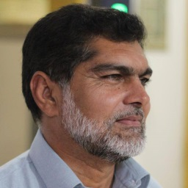
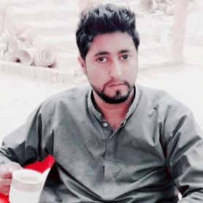
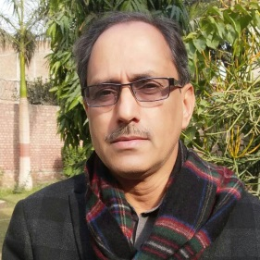
Our Team
Our organization chart of the project management team.
CEO Chairman
Project Manager
Head of Engineering Team
Sale and Promotion
www.4Season swiss.com
12

